Slide 1
Using crowdsourcing and open innovation to hear many voices

Slide 2
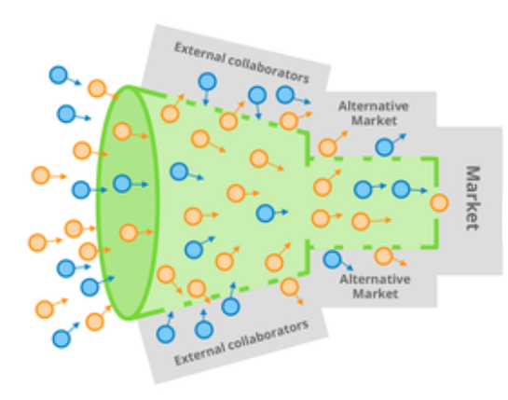
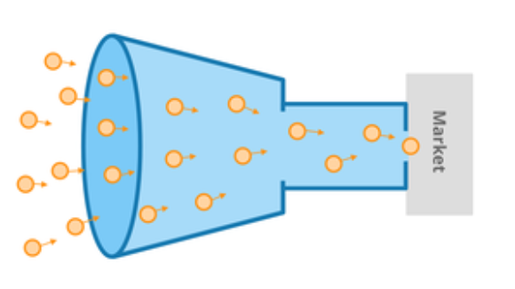
Crowdsourcing
The practice of obtaining ideas, solutions or content by getting contributions from a large group of people online
Collaborators
The wisdom and experience
of many
Feedback
Small, closed group of “experts”
Solutions
Solutions
VERSUS
Feedback
Collaborators
Typical innovation funnel
Crowdsourced innovation funnel

Slide 3
Crowdsourcing: the task we are going to ask you to do shortly
We are going to:
agree the focus of a crowdsourcing challenge
define some challenges (3-6)
create a process
design an engagement strategy
Choose a topic and go to that table:
Services for maternity and the child’s early years (4 months to 5 years) | Tables 1-
Supporting the cultural safety of our workforce | Tables 1-
Improving services for people living with chronic health disease focusing on stroke | Tables 1-
Commission staff (promoting working as a unified system) | Tables 1-

Slide 4
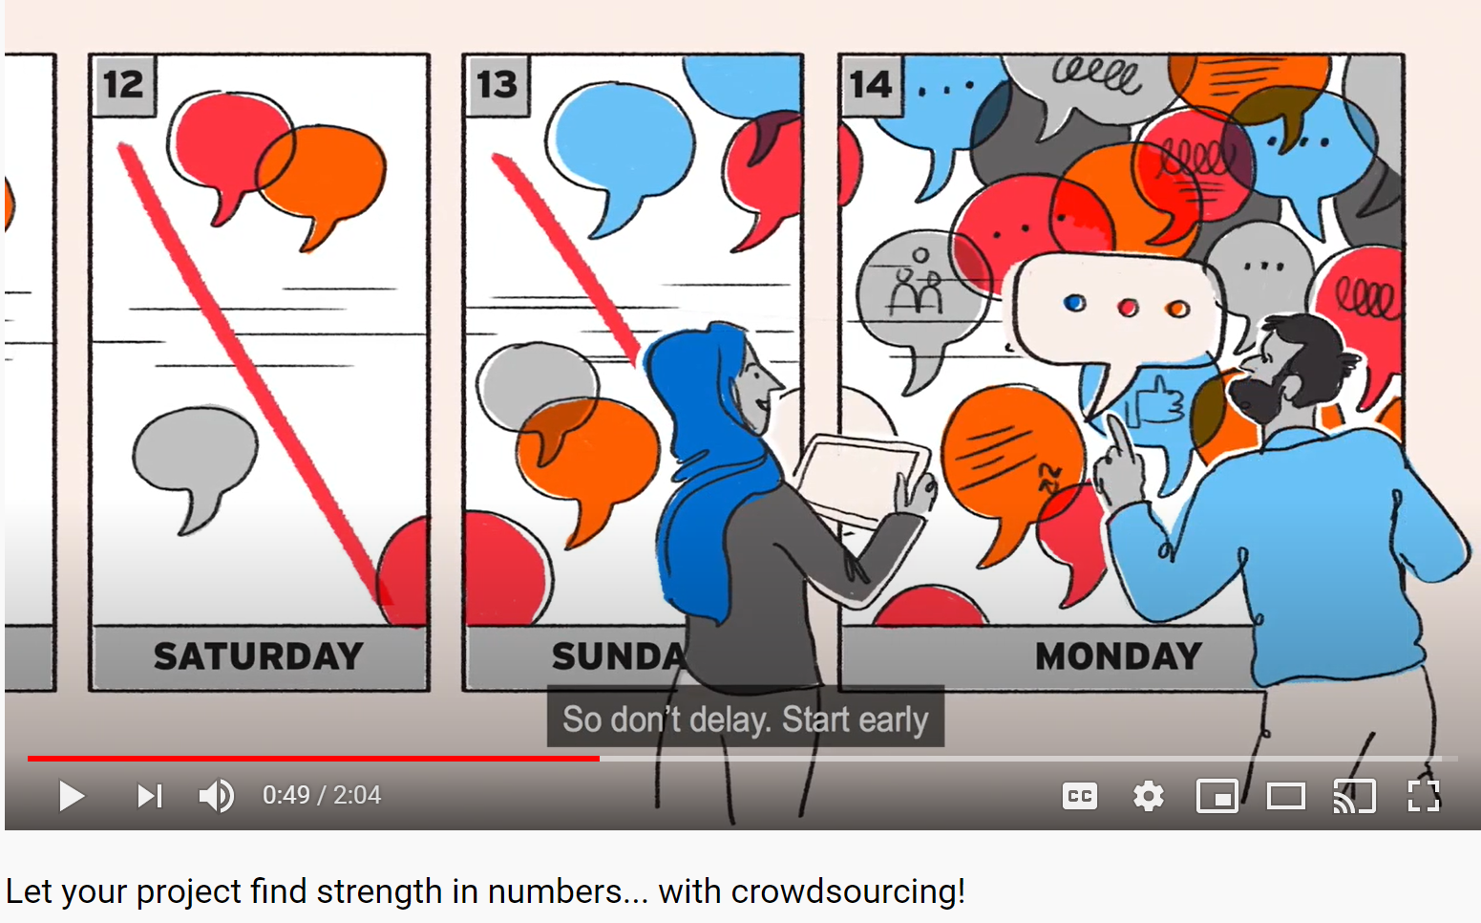
Our film on how to work in this way
https://www.youtube.com/watch?v=YKWIfMrV92c

Slide 5
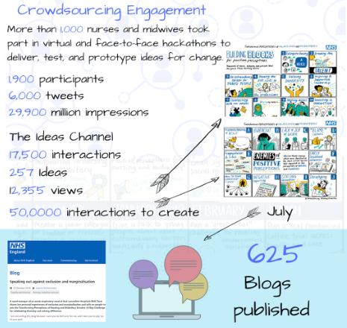
Transforming Perceptions of Nursing and Midwifery
We set up a crowdsourcing platform to capture ideas on how about transform perceptions of nursing and midwifery
It was live for five weeks, supplemented by Twitter chats

Slide 6
Perceptions of Nursing: Challenges
Young people in education
How might we encourage young children in the school system to see that nursing is a fantastic career choice?
How can teachers promote nursing and midwifery as a career choice?
Current Nurses and Midwives
How do we maintain the passion that nurses and midwives feel when they first join the profession?
How can we maintain our own pride in the profession to promote nursing and midwifery to junior colleagues and attract people to start their own journey?
Decision makers in the health and care system
How can we change the way nurses and midwives are recognised so they are seen as a core profession equal to all others in healthcare?
How do we create an environment where nurses and midwives are more involved when making key decisions about healthcare?

Slide 7

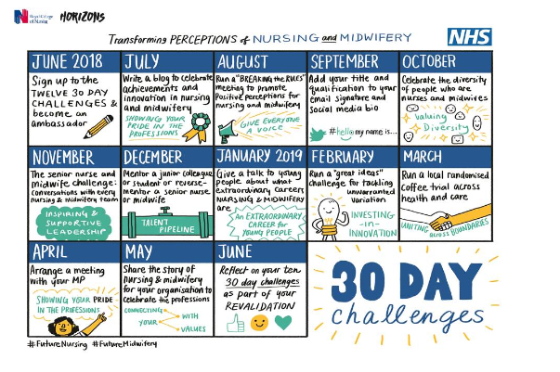

Slide 8
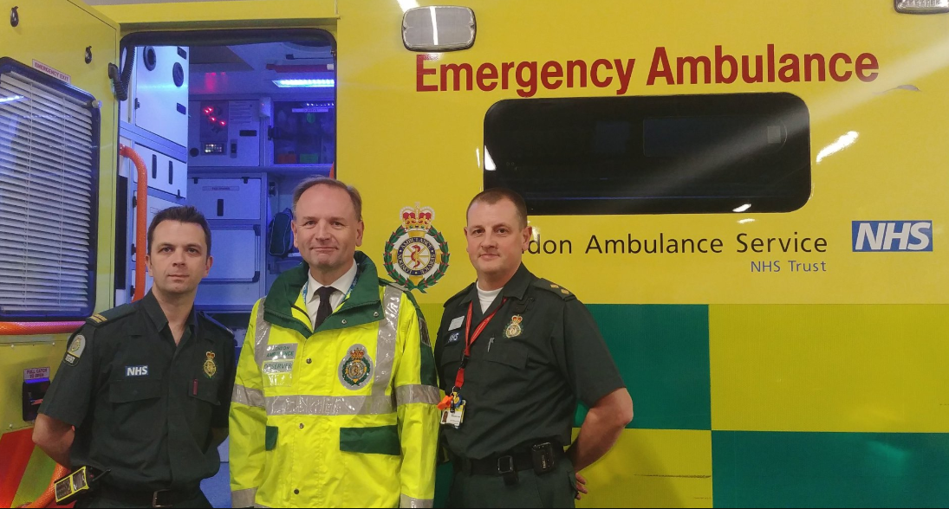
#ProjectA: the starting point

Slide 9
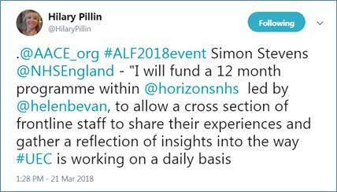
What happened next……

Slide 10
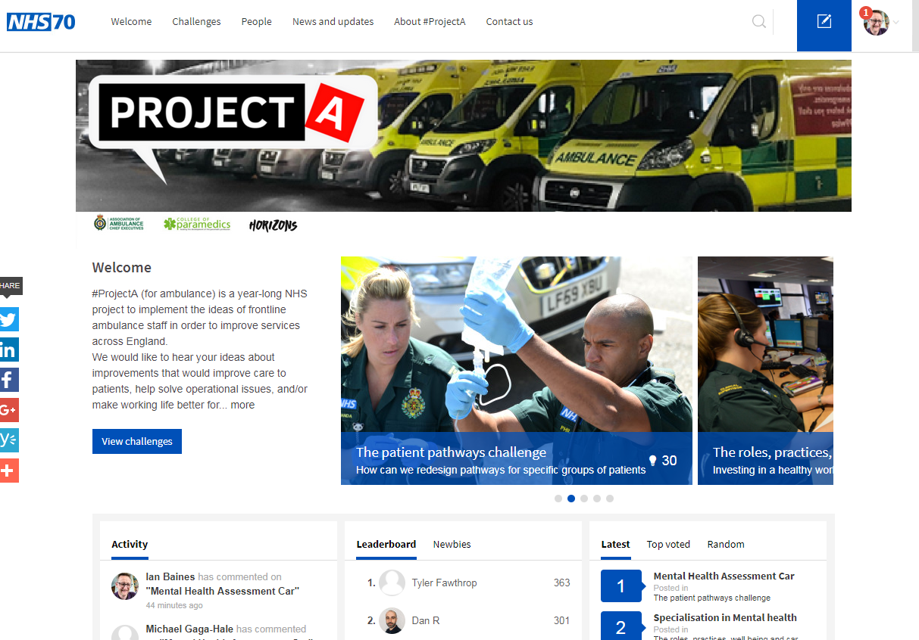
#ProjectA ideas platform
Five challenges
The patient pathways challenge
Partnership with the public challenge
The working with partners challenge
The roles, practices, well being and career progression challenge
The thinking the unthinkable and current “rules” and perceptions challenge

Slide 11
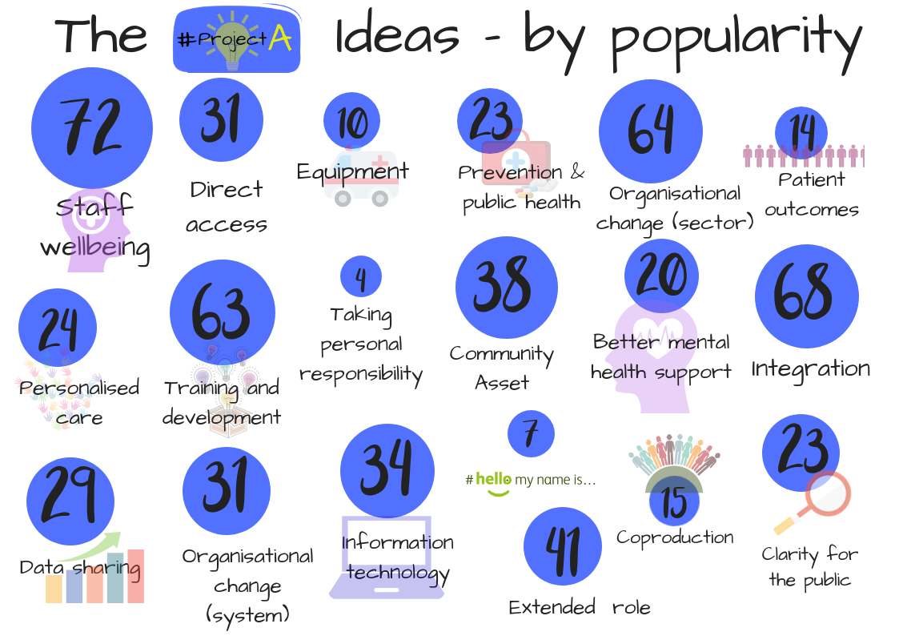

Slide 12

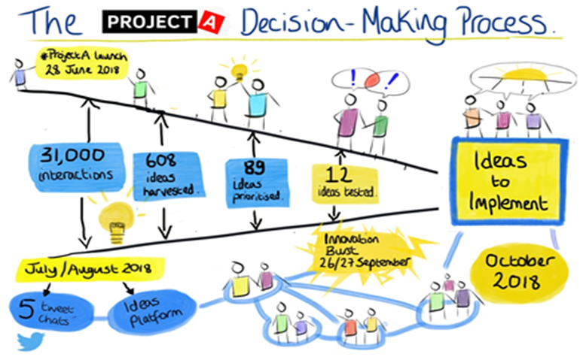

Decision Making Group
#ProjectA

Slide 13

What #ProjectA led to
Action on responding to people who fall
Action on mental health and emotional distress
Action on staff wellbeing
A QI network in ambulance services
Improvements in engagement scores
Virtual collaboration

Slide 14
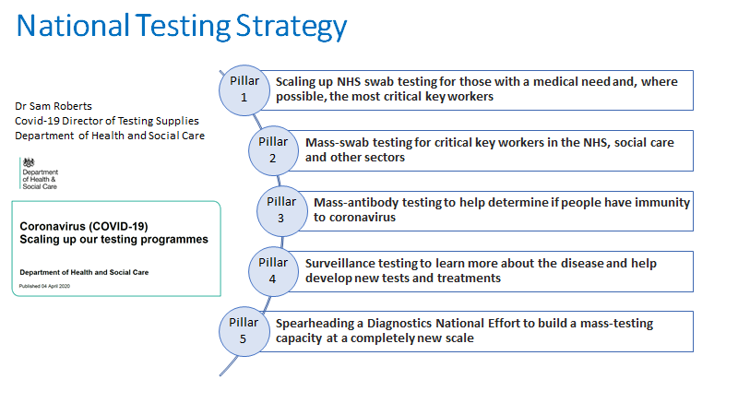

Slide 15

The #Testingmethods2020 pathway
Set the challenges
1.
  A convening group set of champions set challenges to generate solutions to some the biggest science/clinical issues we are facing with Covid-19 testing.
2.
  “Champions” review and categorise the solutions and respond to authors.
Review
3.
  “Ready to deploy” solutions are either communicated to lab networks via weekly bulletin or go via a validation route if they are commercial offers.
Implement
4.
Feedback
  Impact, uptake, spread and learning is captured, monitored and shared.

Slide 16
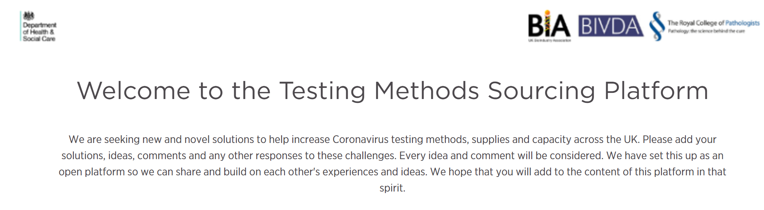
The challenges
RNA extraction: New methods
Transport media to inactivates the virus
Dry Swabs for use in virus detection
Point of Care Testing - desktop PCR equipment
Low volume blood collection and sample elution for serology testing
Alternatives to swabs for sampling
Increasing end to end efficiency and speed of testing
Categories
Does not address the challenge posed
Maintain interest and watch progress
Have potential but need additional support, development or validation
Ready to go – able to contribute to scaling of testing
Can contribute to testing strategy but do not address the challenge posed

Slide 17
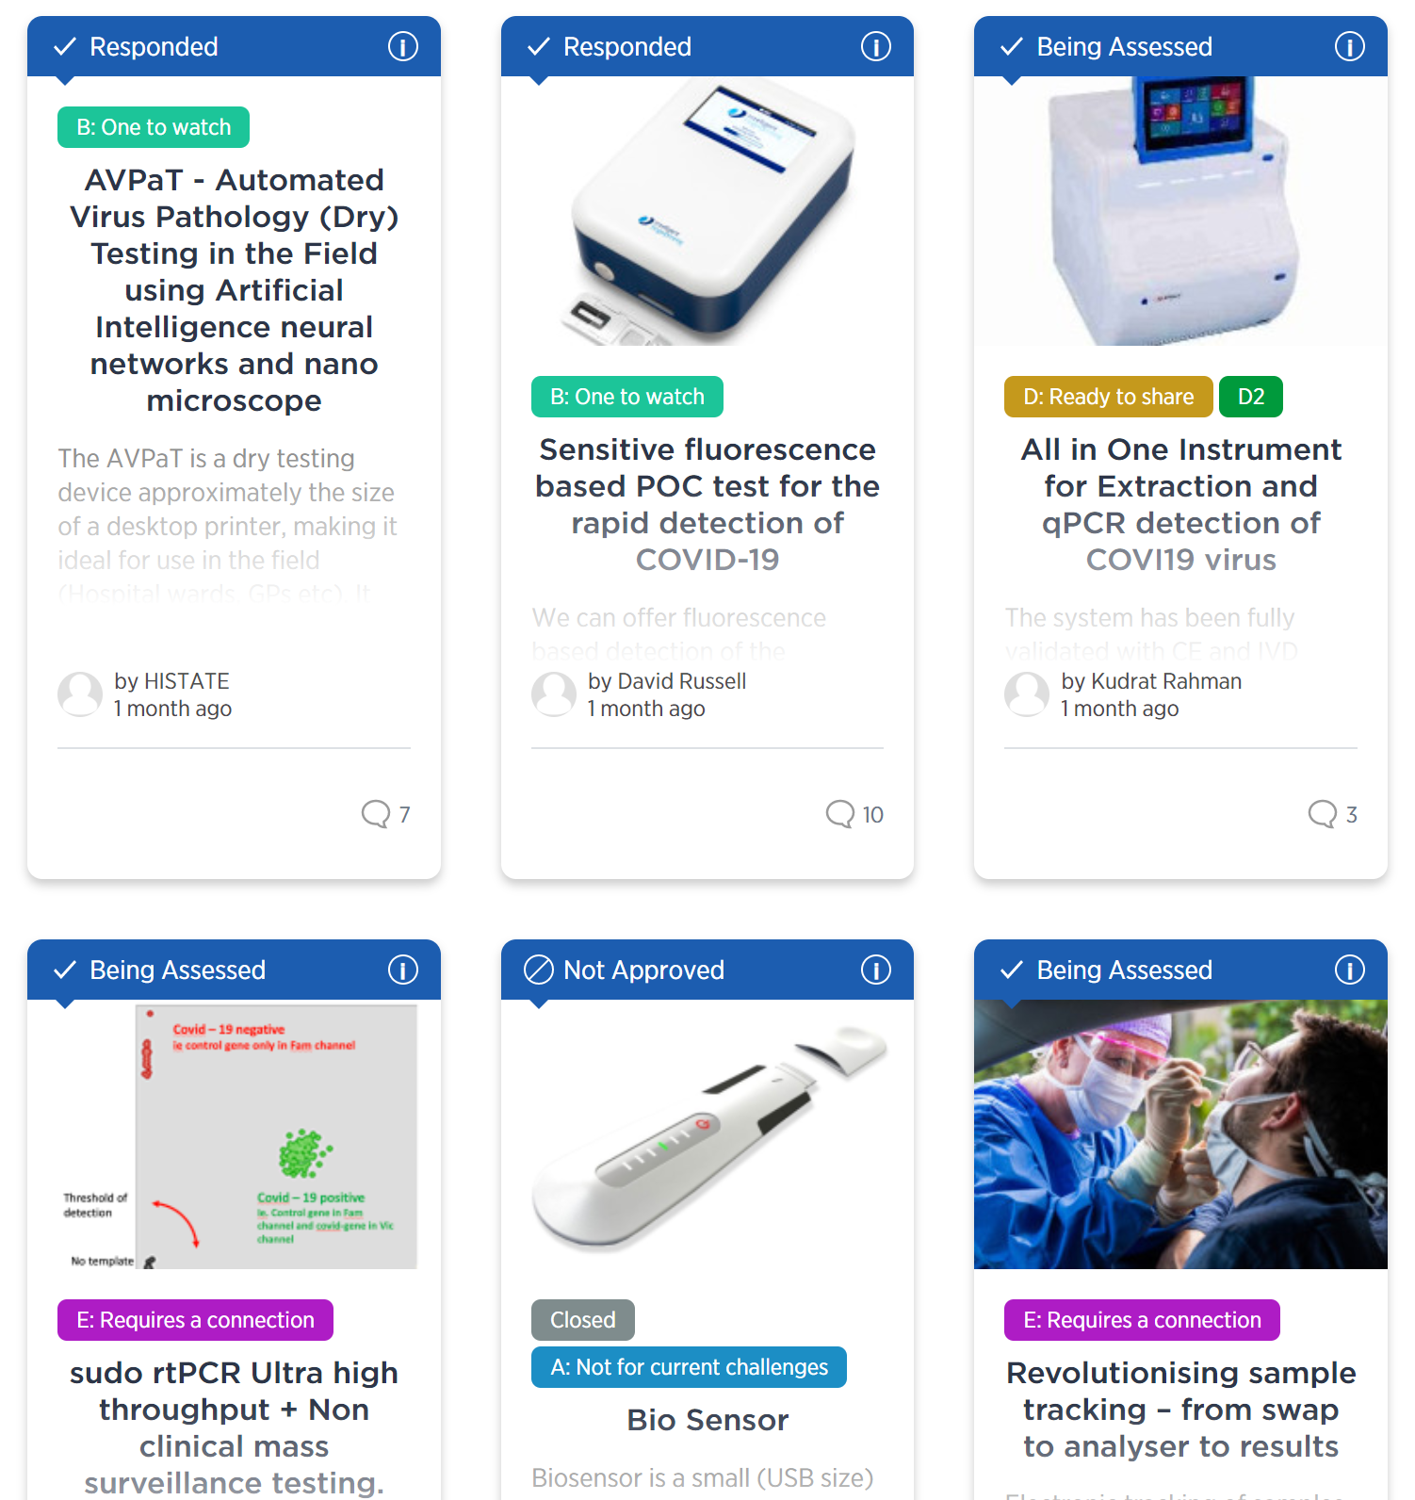

testingmethods.crowdicity.com/

Slide 18
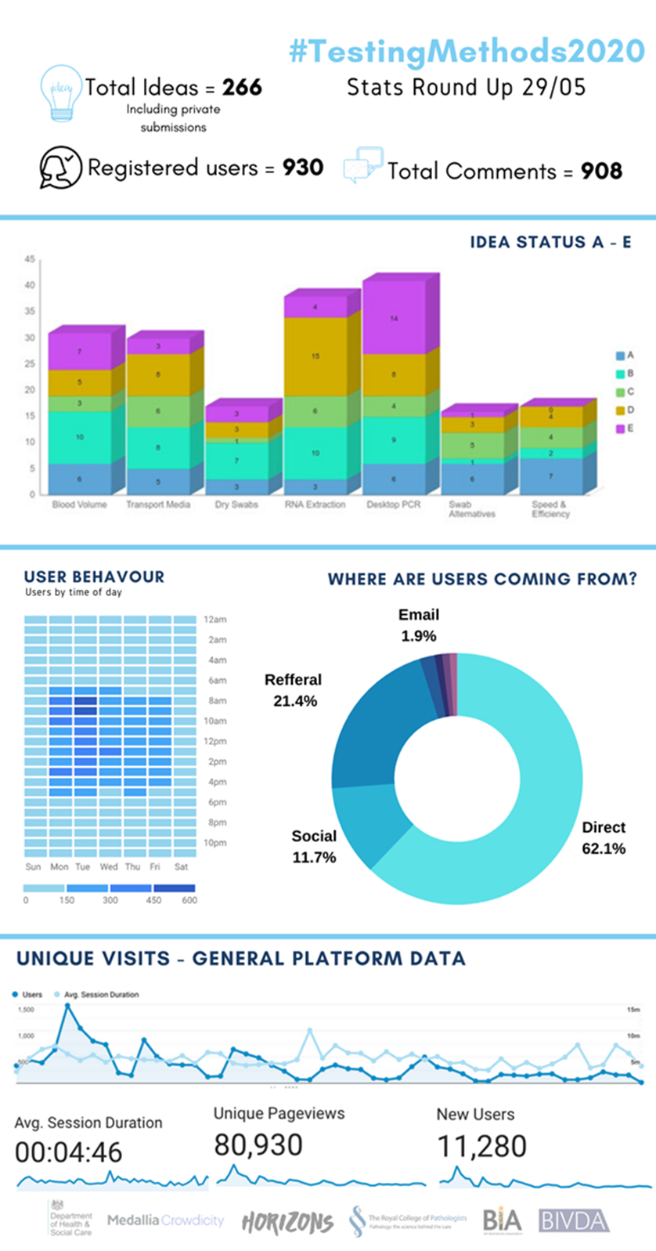
The Platform Activity:
Notes:
18
18
18
18
18

Slide 19
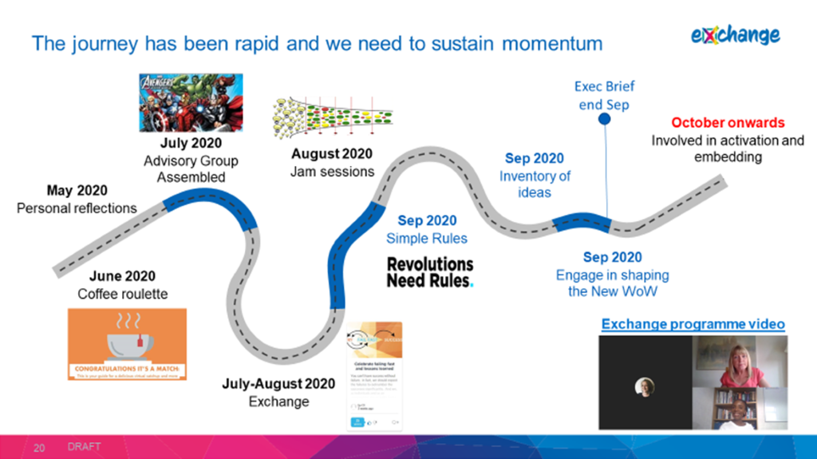
Exchange: a collaborative culture change

Slide 20

Coffee Roulette
Over 1,000 people signed up for Coffee Roulette conversations
Conversations took place in pairs, in teams, between teams or in networks.
People were invited to sign up to be randomly paired with another colleague in a special Coffee Roulette to share reflections over a 30-minute call.
After the virtual meet-up and conversation, we asked people to share their feedback.

Slide 21
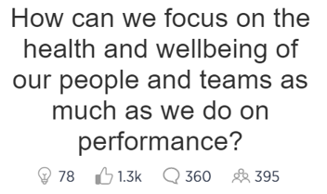
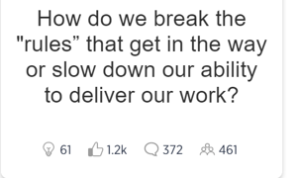

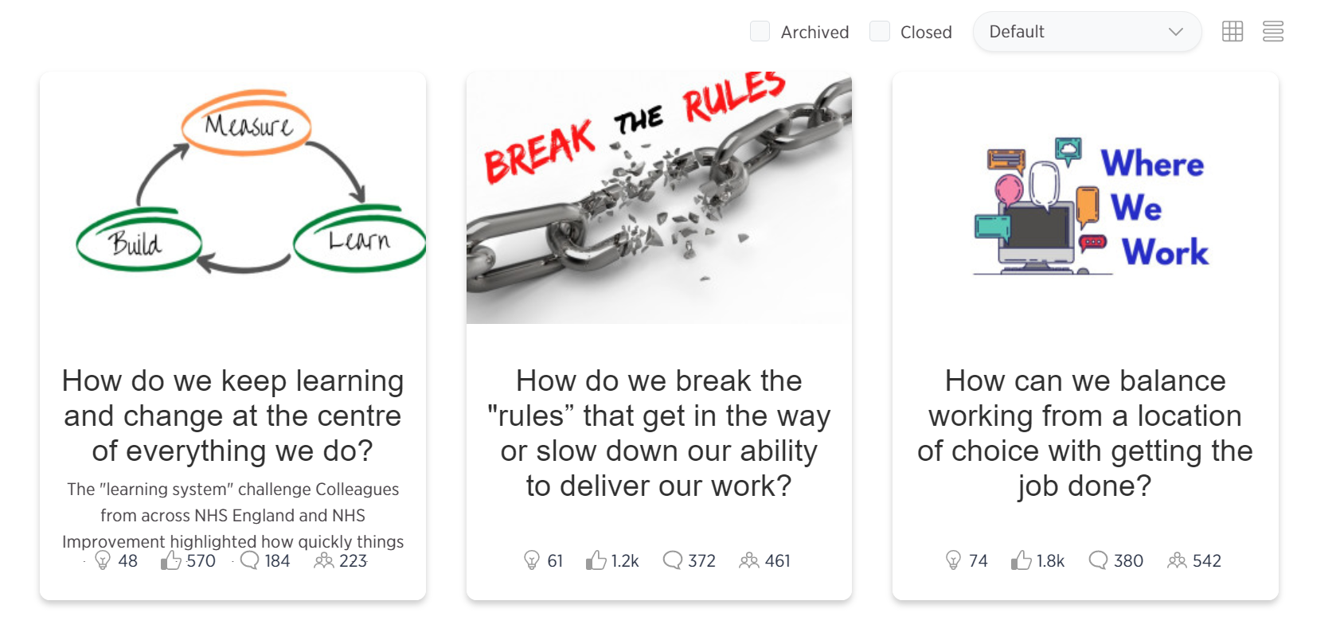

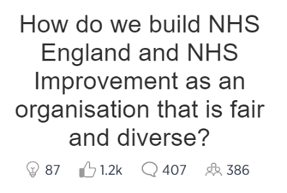

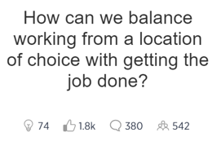







Slide 22

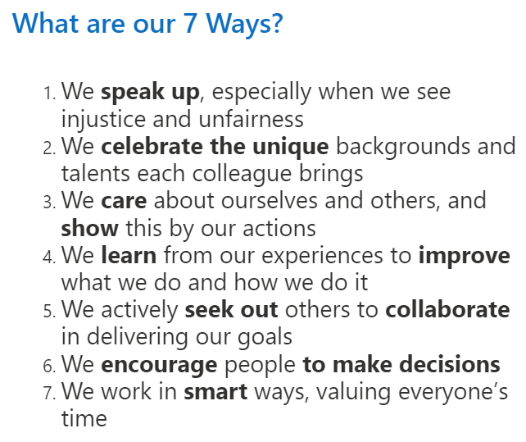

Slide 23
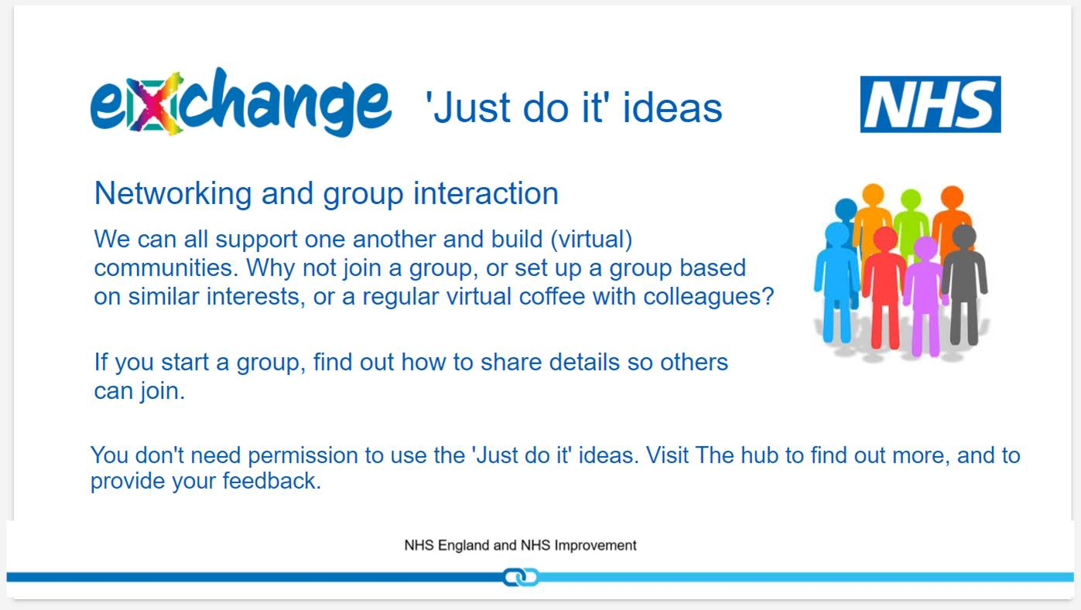
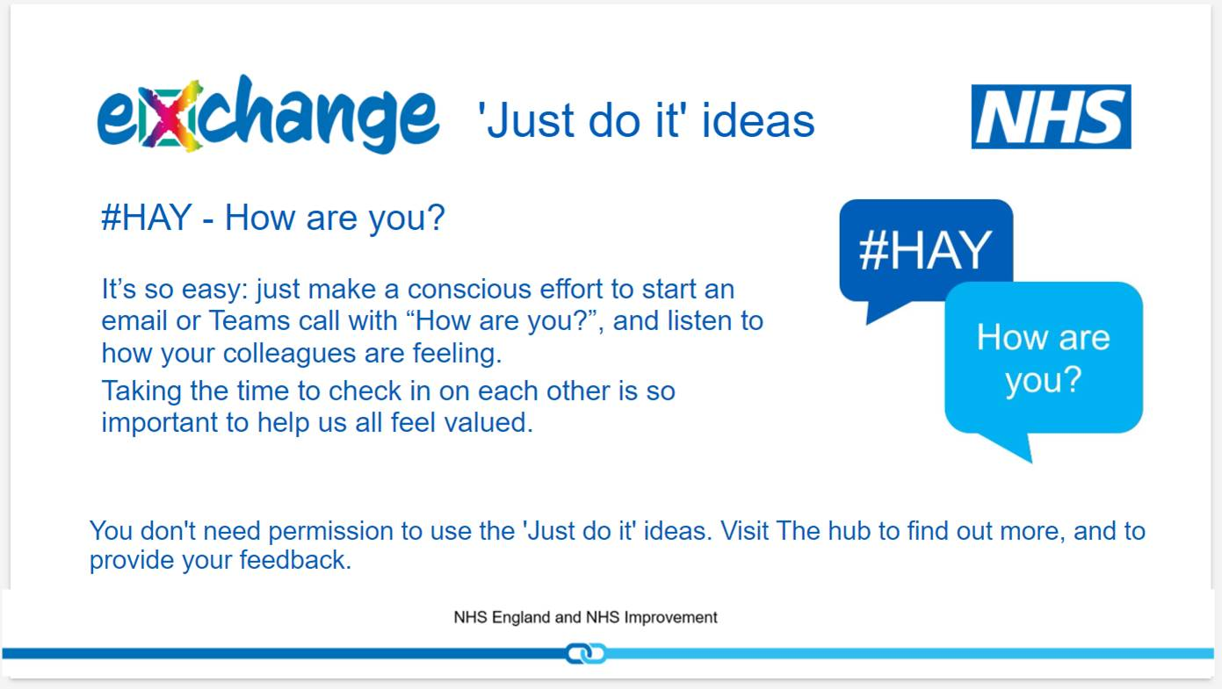
Just Do Its

Slide 24
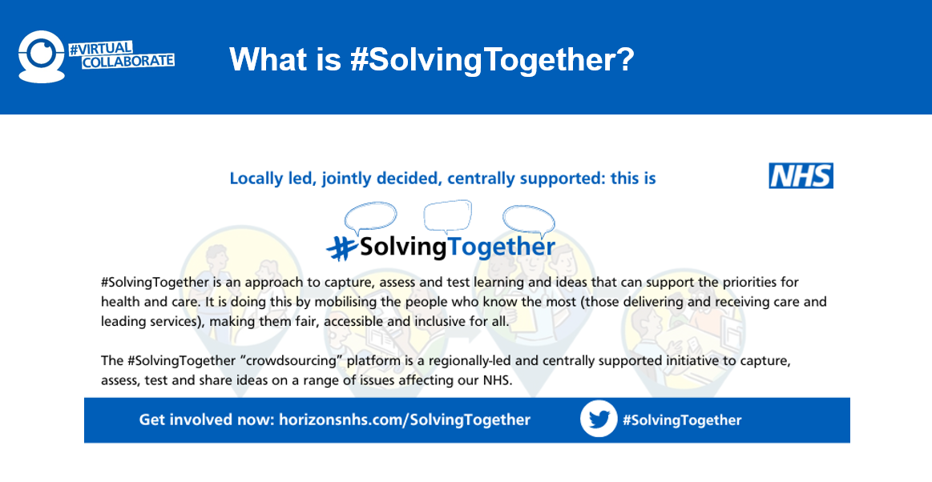
solvingtogether.crowdicity.com/category/browse

Slide 25
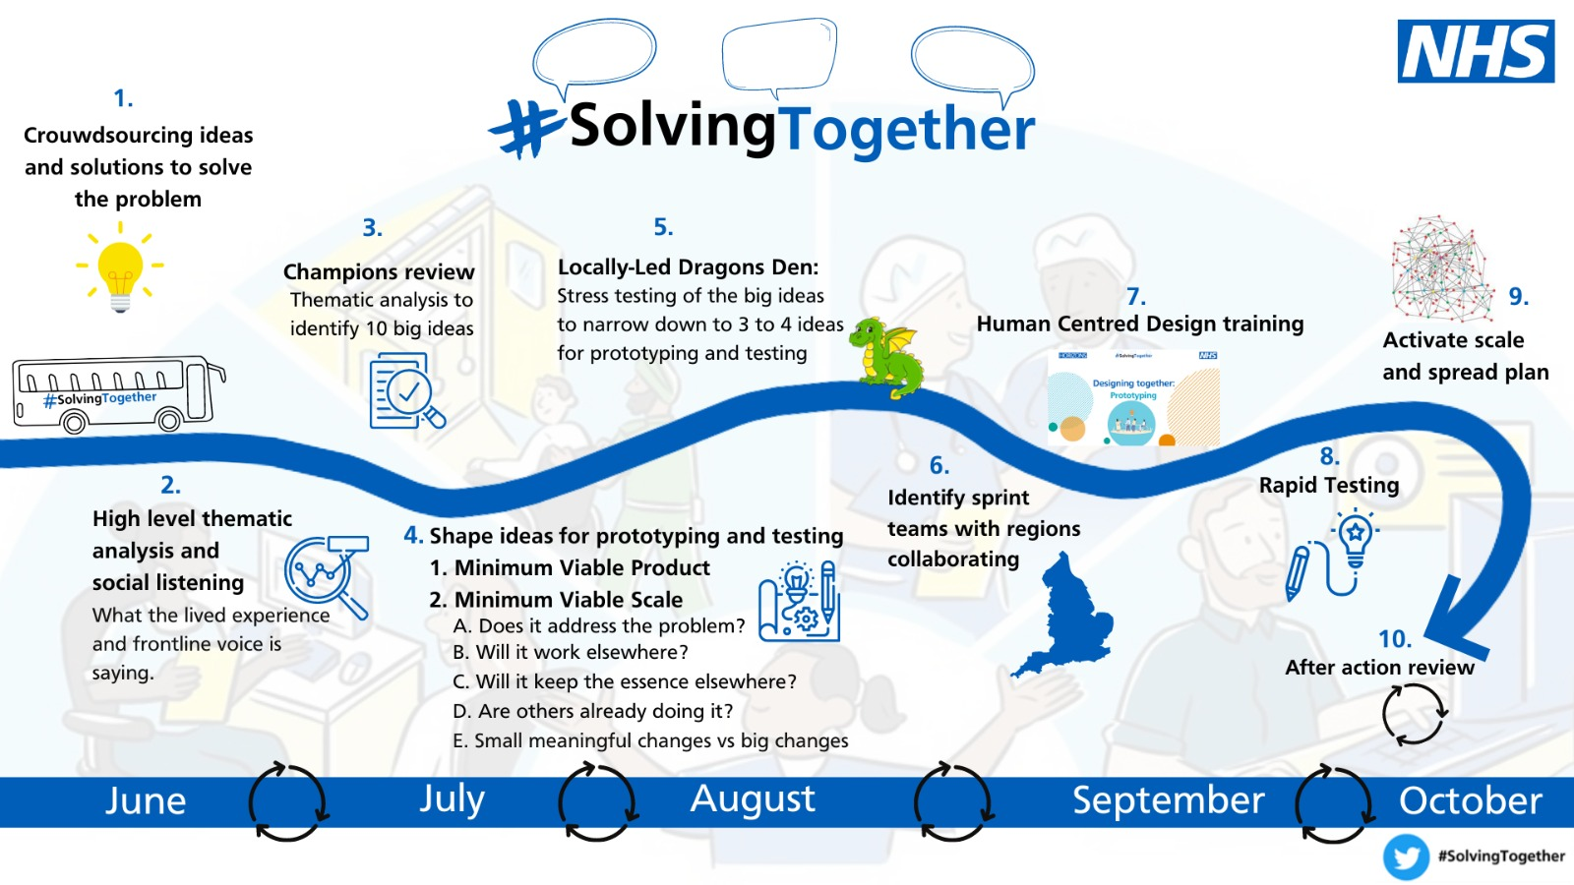

Slide 26
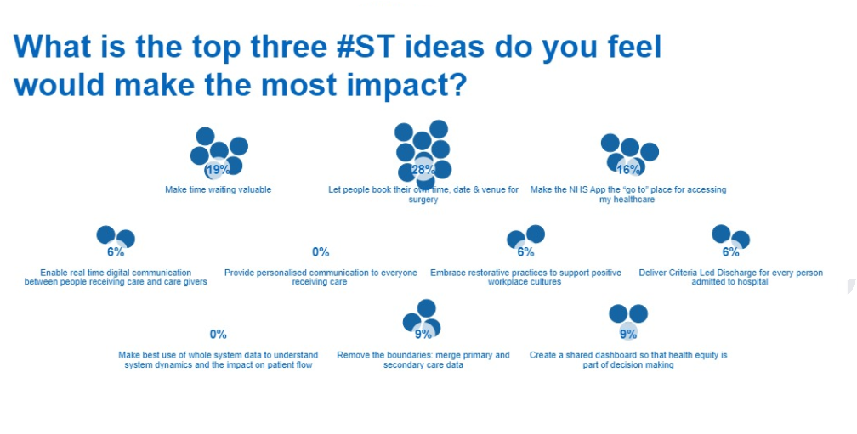

Slide 27

The tests we apply to crowdsourcing ideas
Prototyping: creating a simulation or sample version of a new idea to see if it is worth doing
Context testing: testing the feasibility and practicality of an initiative that is already working in one or more parts of the country to the rest of the country
Fidelity testing: testing whether the basic principles of the new idea can be recreated in full elsewhere without losing the impact
Discovery: learning what is happening where that is similar to this idea and determining whether this information will have an impact on the scalability of the idea
Testing fit: testing how the new idea fits with other initiatives, priorities and systems
Combination testing: merging ideas so that the sum is greater than the parts
Real time developing: creating and testing a resource (e.g., a directory of ideas or practices)

Slide 28

What is social listening?
Social listening is:
Looking beyond the actual content on the platform to consider the “mood” or emotional tone behind what people have written (sentiment analysis) and identify what matters to them
Reviewing the information for ways to put what we learn into action

Slide 29
Social listening: what matters to people who use services?
People who use services want more control or power over what is happening to them:
Knowing what is going on, whether I’m waiting for an appointment or waiting to be discharged from hospital; I want to I feel confident about booking my holidays or making family or work plans knowing that the arrival of an appointment letter or surgical date or lack of clarity about my discharge date won’t mess things up
Feeling connected to and cared for by the system
Access to knowledge and support
A personalised approach that fits with my priorities: not everyone who is waiting for a joint replacement wants to go swimming

Slide 30
Social listening: what matters to people who work in the system?
People who work in the system want:
To have more control over our working lives
To be able to act consistently with our own values (including addressing moral injury)
More focus on the things we “want to” do rather than “have to” do
To join things up more
To feel valued, respected and supported
A sense of progress
To experience effectiveness at work and deliver valued outcomes

Slide 31
Six things to do in response to “what matters to me”:
Prioritise actions that give patients a better sense of control, even though they may have to wait, eg, EVERY patient should have a estimated discharge date and a plan that has been jointly decided
More explicitly link service recovery to people recovery; undertaking service recovery work through processes that enables people to contribute in a way that gives them more autonomy and a sense of contributing to a bigger purpose
Focus activities on what NHS people can control and influence
If elective recovery is a mandate (“have to”) rather than a choice (“want to”), stress the choices and autonomy that people and teams have
Create "Trojan mice" (many small, well focussed changes to probe complex problems) rather than "Trojan horses" (large pilot and roll out projects)
Take steps to build an “outward mindset” to elective recovery at every level of the system

Slide 32
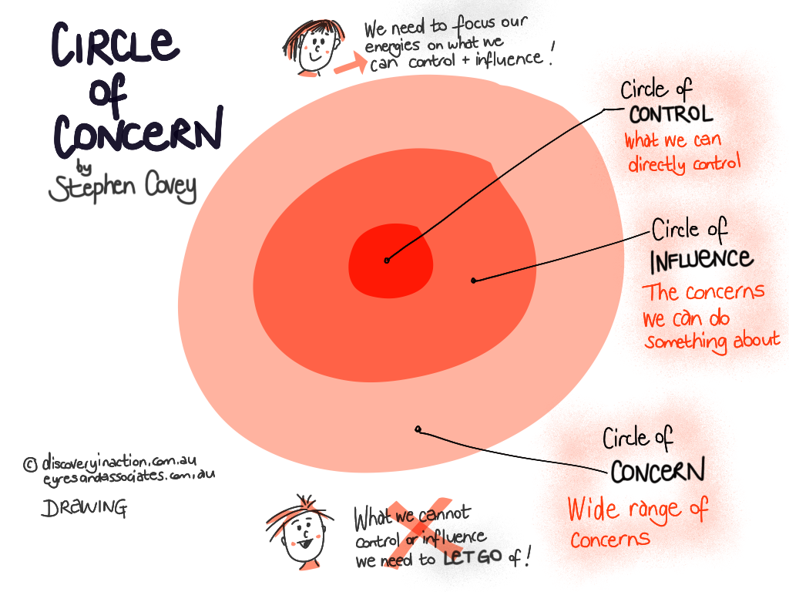
More focus on the things that we feel able to control or influence
We focus our energies on what we CAN control and influence
We do not focus on what we cannot control or influence
What we can control
What we can influence
What’s outside of our control

Slide 33
Urgent and emergency care
futureuec.crowdicity.com/

Slide 34
Crowdsourcing: to think about
What are your aims?
Is this the right methodology?
Who is in our crowd?
How to motivate people to respond?
Who will fulfil the roles?
  Community managers
  “Champions”
How to work in co-production
What/how many challenges?
What criteria for assessment?
What follow up with contributors?
What will you do with the ideas?

Slide 35
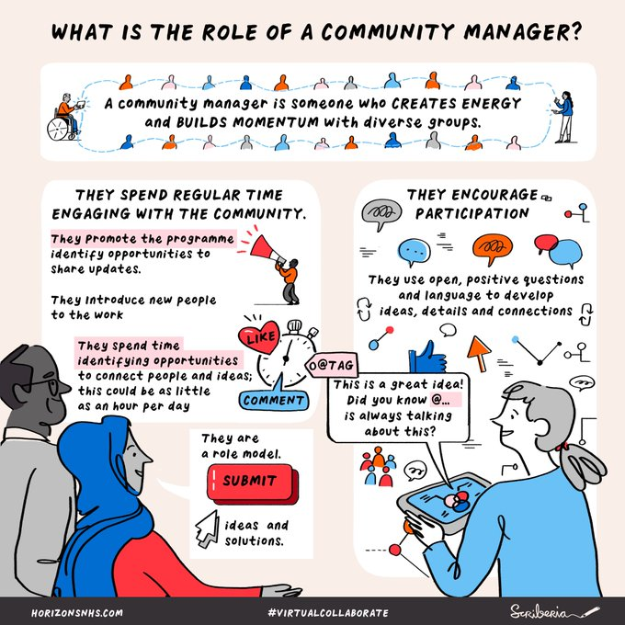

Slide 36
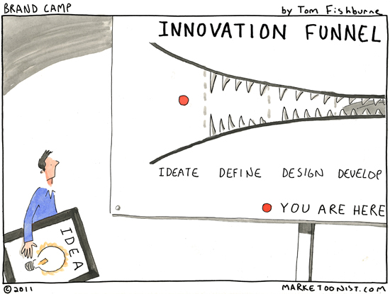
Learning
95% relational, 5% technical
Co-create with the people you want to be involved in the change
Pick wise, committed, influential people to be your champions and support them
Very active community management
Be transparent
Know when to stop
Always, always follow up
@HelenBevan #insighttoimpact

Slide 37
Crowdsourcing: task
We are going to:
agree the focus of a crowdsourcing challenge
define the challenges
create a process
design an engagement strategy
Choose a topic and go to that table:
Services for maternity and the child’s early years (4 months to 5 years) | Tables 1-
Supporting the cultural safety of our workforce | Tables 1-
Improving services for people living with chronic health disease focusing on stroke | Tables 1-
Commission staff (promoting working as a unified system) | Tables 1-

